Slide 1
Animal Science 2-Small Animal
Unit D-Animal Breeds and Basic Management

Slide 2
Essential Standard 10.00
Select the best fish, amphibian, and reptile for a given use.

Slide 3
Objective 10.01
Discuss the major breeds of fish and types of amphibians and reptiles.

Slide 4
Species/Breeds of Fish
Egg laying fish
Koi
Goldfish
Betas
Tetras
Barbs
Catfish
Chinese Algae Eater Headstanders

Slide 5
Goldfish
Very popular first fish for many children
Hardy and easy to keep freshwater fish that prefers pools or cold water aquariums
Prefer a temperature range of 32-68˚F
Can live in various types of water as long as water is kept clean

Slide 6
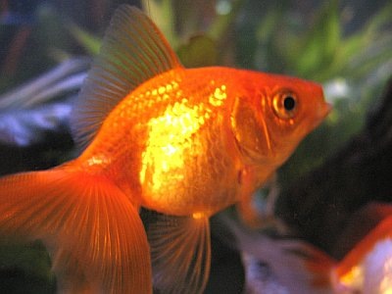
Goldfish

Slide 7
Betas
Freshwater fish that are very aggressive
Frequently kept alone as a specimen fish in a species-only aquarium
Males must never be put in the same aquarium
One or two females may be put in a community aquarium but it may affect their coloration
Prefer a temperature range of 80˚F ± 3˚

Slide 8
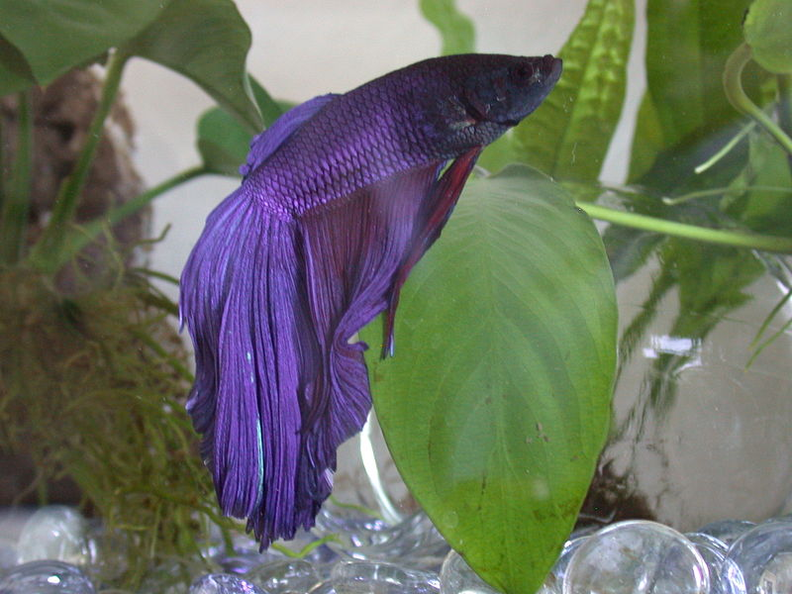
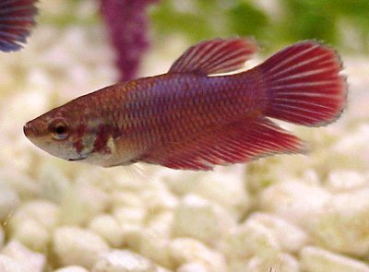
Betas
Female Beta
Male Beta

Slide 9
Tetras
Easy to medium care ornamental fish that prefer soft water that is slightly acidic
A very sociable fish that does well in community aquariums
Average 1 ½-3” in length
One species is the neon

Slide 10
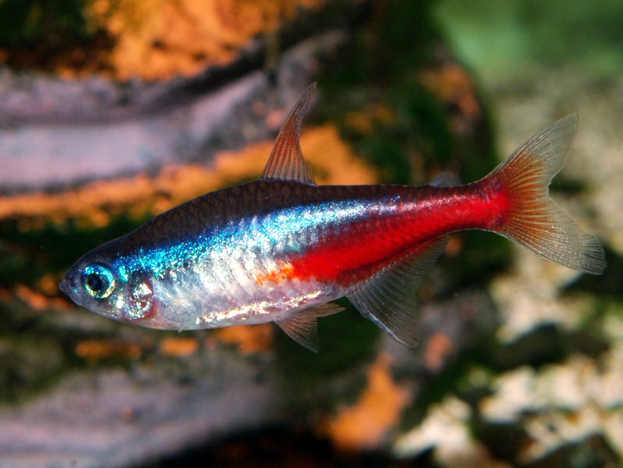
Tetras

Slide 11
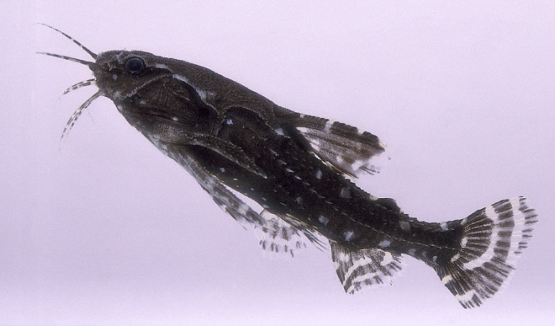
Catfish
Grown as ornamentals including the upside-down catfish, glass catfish, and electric catfish
Prefer their water temperature to be 70-80˚ F

Slide 12
Chinese Algae Eater
Soaking loach that grows up to 10” long when the aquarium size permits
Large, fleshy lips that can cling to vegetation, rocks or the sides of a glass aquarium
Good community fish and feed off algae
Prefer a water temperature of 70-80˚F

Slide 13
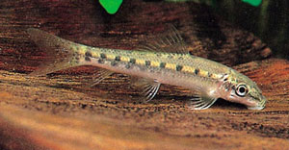
Chinese Algae Eater

Slide 14
Livebearing fish
Give birth to live young
Live in shoals or groups of five or more
Guppies
Swordtails
Mollies
Platys

Slide 15
Guppies
Most popular
Varieties only differ in shapes of their fins and tails
Prefer water temperatures 68-75˚F
May average giving birth to 50 young, but adults may try to eat the young fry

Slide 16
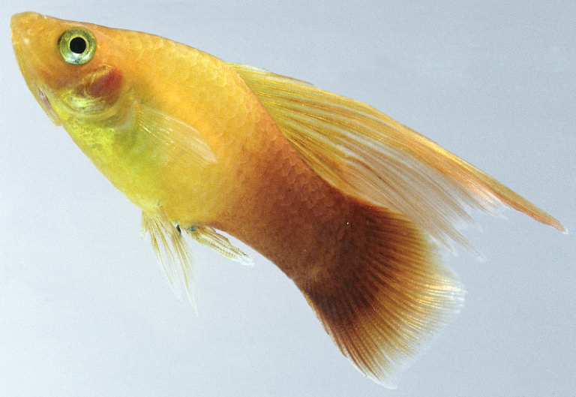
Guppies

Slide 17
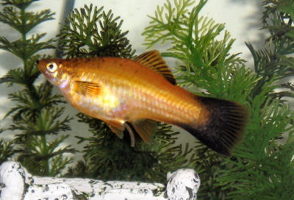
Swordtails
Known for its long sword-like caudal fin
Like environment similar to guppies
Average 3-4 ¾” long
Prefer water temperatures 68-70˚F

Slide 18
Mollies
Most species are black and differ only in the size of their fins
Prefer water temperatures 72-82˚F
Dwell in large groups or schools
Have problems with large fins (may grow so large that swimming is difficult)

Slide 19
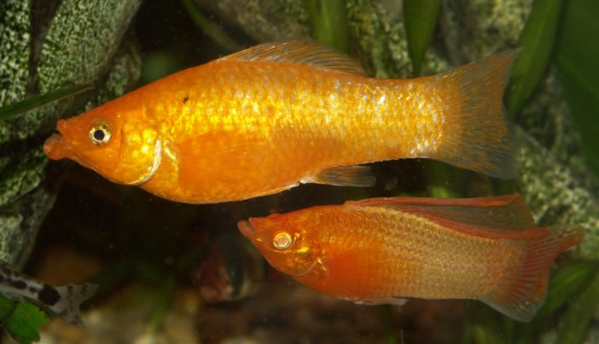
Mollies

Slide 20
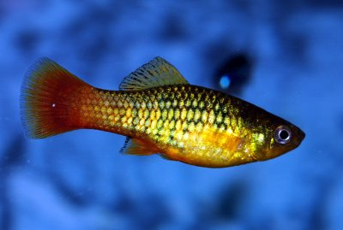
Platys
Very popular
Average only 2 ½” in length
Prefer water temperature 68-77˚F

Slide 21
Saltwater Breeds
Live in saltwater and require the addition of sodium chloride (salt) to create a marine environment
Most of these ornamental fish lay eggs
Angelfish
Butterfly fish
Brasslets
Clown fish
Sergeant Major

Slide 22
Angelfish
Some can live in freshwater
Delicate in appearance, but are very hardy
Eggs are carried in the parent’s mouth and placed either in foliage or sand as part of the incubation process
Prefer water temperature of 77-86˚F

Slide 23
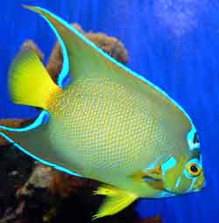
Angelfish

Slide 24
Brasslets
Small, popular, colorful fish for marine aquariums
Royal gamma is the suggested brasslet for beginner marine aquarists
Mix well with other species, but must be isolated from their own due to aggressive nature
Eat a diet of brine shrimp
Prefer water temperatures 79-82˚F

Slide 25
Clown Fish
Orange in color with three white bands encircling the body
Each white band & fins are edged in black
Known for their ability to live around the tentacles of the sea anemone in a mutually beneficial relationship known as symbiosis

Slide 26
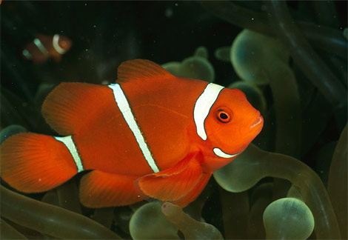
Clown Fish

Slide 27
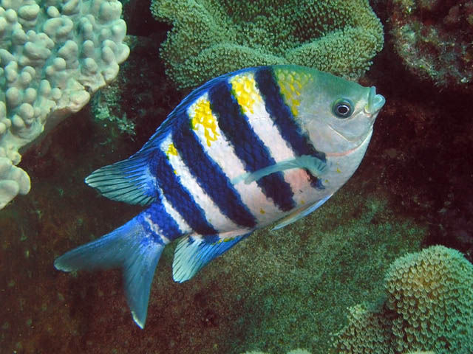
Sergeant Major
Marine fish that grows to 7” in length
Silver-blue in color with a yellow tinge on its body and has seven vertical dark bands on each side.

Slide 28
Breeds of Amphibians
Newts
Salamanders
Frogs
Toads

Slide 29
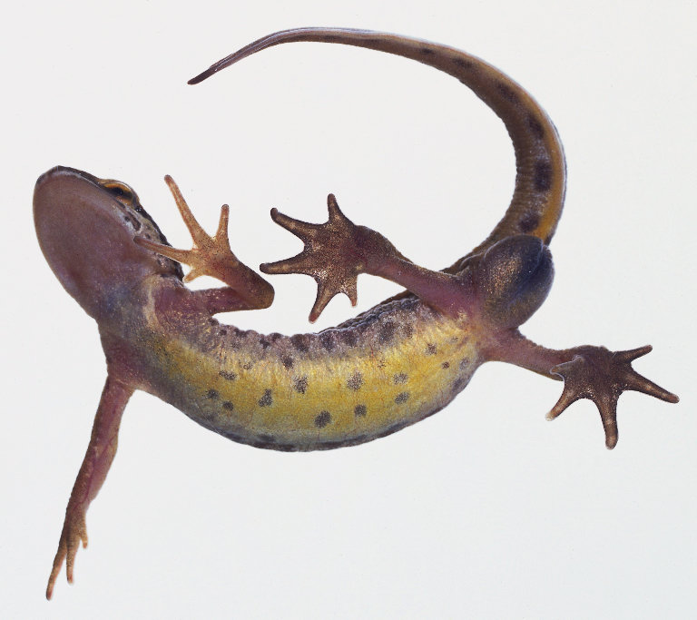
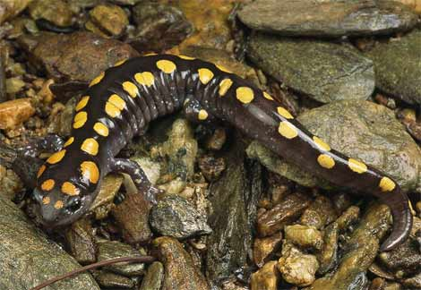
Newts and Salamanders
Range in size from a few inches to 5’ or more
Usually have four legs and long tails

Slide 30
Frogs and Toads
Differ in that frogs make a croaking noise, have slender, longer bodies, and moist skin while toads have a rough skin and dry appearance
True frogs include the American Bullfrog and may grow to 14” long

Slide 31
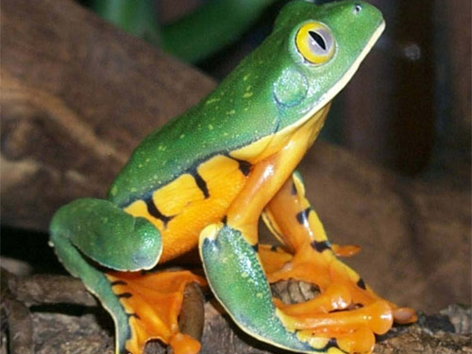
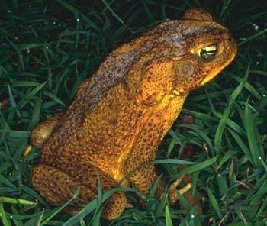
Frogs and Toads
American Toad is the common toad in the eastern United States
Green Tree Frog is actually a yellow-green toad with a yellow stripe running from its lower jaw back along its sides

Slide 32
Species of Reptiles
Boa constrictors
Garter snakes
Green anole
Skinks
Savannah Monitor
Chameleon

Slide 33
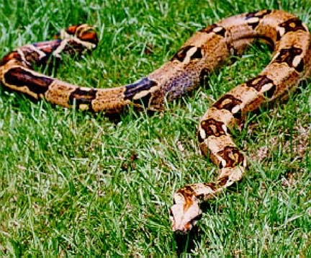
Boa Constrictors
Popular pets because they adjust well to captivity and tame quickly
May grow 18’ long
Like to feed on small animals, birds, fish, and eggs

Slide 34
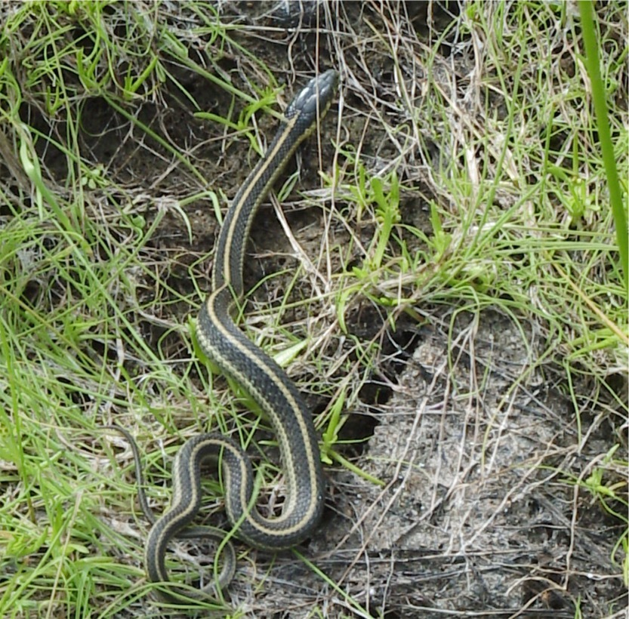
Garter Snakes
Adjust well in captivity and can be tamed
Easily recognized by stripes running the length of their body
May reach 2-3’ in length

Slide 35
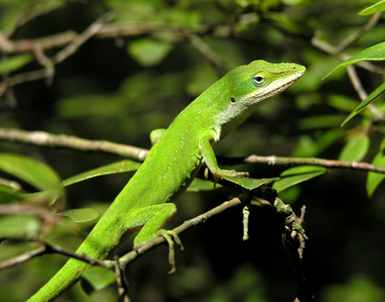
Green Anole
An iguana that is often found in pet stores
Reaches a length of 8” and feeds on insects
Changes color from various shades of gray to brown

Slide 36
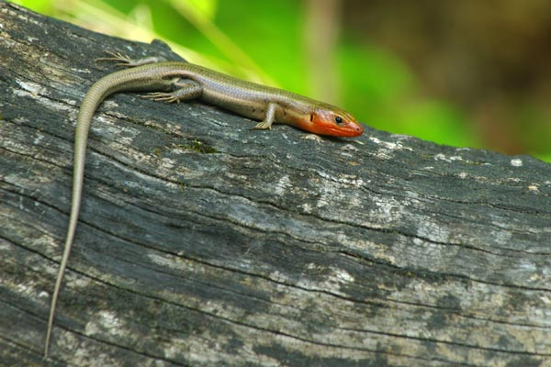
Skinks
Very tame and make excellent pets
Secretive and do best with leaves to burrow under
May reach 2’ in length

Slide 37
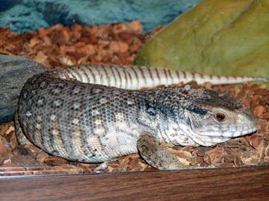
Savannah Monitor
A lizard that can be used as a pet
May reach sizes up to 6’ or more and become hard to handle

Slide 38
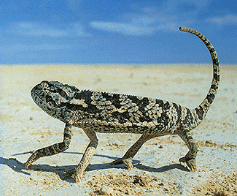
Common Chameleon
A true chameleon that reaches about 10” in length
Can change their colors rapidly to adapt to their surroundings

Slide 39
Terminology
Ornamental fish-
Kept for their appearance (bright colors and fancy fins)
Personal appeal to people
Not usually used for food

Slide 40
Terminology
Tropical fish
Popular fish for aquariums that come from the warmer regions of the world

Slide 41
Terminology
Marine fish
Fish that are kept in salt water aquariums
Often more colorful than freshwater varieties

Slide 42
Terminology
Freshwater fish
Fish that are kept in a freshwater tank
Often the most popular fish for pets

Slide 43
Terminology
Community fish
Fish that do well in an aquarium with other fish species
Examples include: Tetras, barbs, catfish, Mollies, Platys, and Swordtails

Slide 44
Terminology
Species fish
Do best in an aquarium with fish of the same species
Examples: Blind Cave Fish, Piranhas, Red-Tailed Shark, Schomburgk’s Leaf Fish, Spiny eels, Killifish (one pair alone in an aquarium), Betas (alone in an aquarium)

Slide 45
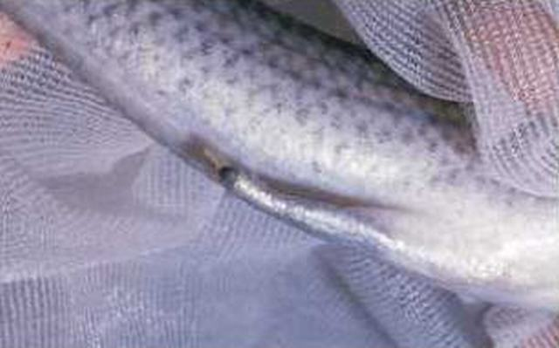
Terminology
Gonopodium
Modification of anal fin into a tube-shaped organ in male live-bearers that provides passage for sperm packets to enter the oviduct of the female

Slide 46
Terminology
Live bearer
Fish that give birth to live young
Examples: guppies, Mollies, Platys, and Swordtails

Slide 47
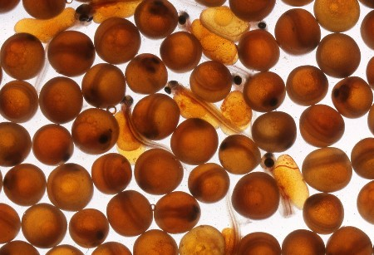
Terminology
Egg layers
Fish that expel eggs from the female to be fertilized by the male
Examples: tetras, barbs, catfish, goldfish

Slide 48
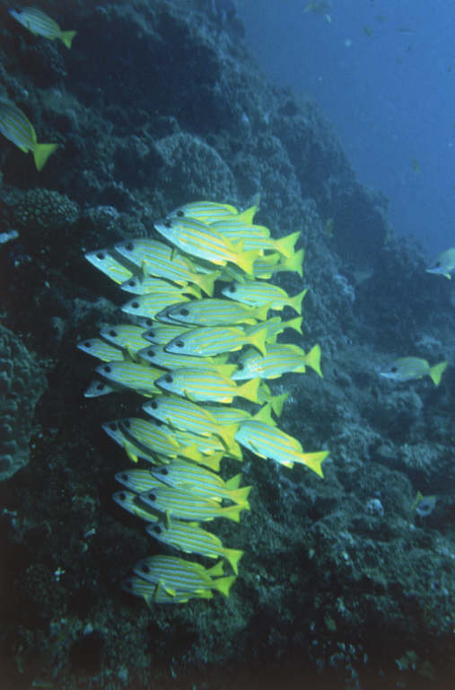
Terminology
Shoals
Small colonies of fish
Some species prefer to live in shoals
Examples: African refin, catfish, tetras

Slide 49
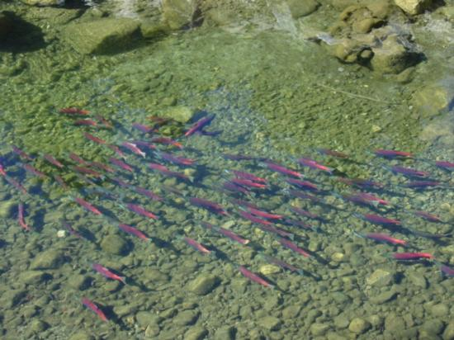
Terminology
Spawning
The reproduction ritual where eggs are deposited and fertilized by egg laying species of fish

Slide 50
Terminology
Scales
Thin, bony plates that develop from and are embedded in dermis
Overlap each other and provide protection
Exposed part of the scale is covered with a thin layer of epidermis that produces a slimy mucous which protects the fish from water borne bacteria

Slide 51
Water/Salt Requirements
Fish must maintain proper levels of salt and water in their bodies.
Water flows from areas of weak salt solution to areas of strong salt solution by osmosis.

Slide 52
Water/Salt Requirements
Freshwater fish do not need to drink water because their body concentration is higher than the water
Saltwater fish have a lower concentration of salt in their bodies than in the water. Therefore, they must drink water to keep from dehydrating.

Slide 53
Feeding Habits
Bottom feeders (dwellers) are fish that inhabit the lower level of the aquarium and feed off the bottom.
Their mouth may be turned down or underslung and they may have barbs to help them locate food.
Example: barbs

Slide 54
Feeding Habits
Middle feeders (middle-water fish) primarily occupy the middle layer of the aquarium and usually have small mouths that are straight forward because they are eating feed that is straight in front of them.

Slide 55
Feeding Habits
Top feeders usually eat from the surface and occupy the upper levels of the aquarium.
Often, their mouths will be turned upward and they will have long streamlined bodies designed for rapid movement to help them catch insects.

Slide 56
Feeding Habits
Some fish, like goldfish, do not show a preference for the level of the aquarium.

Slide 57
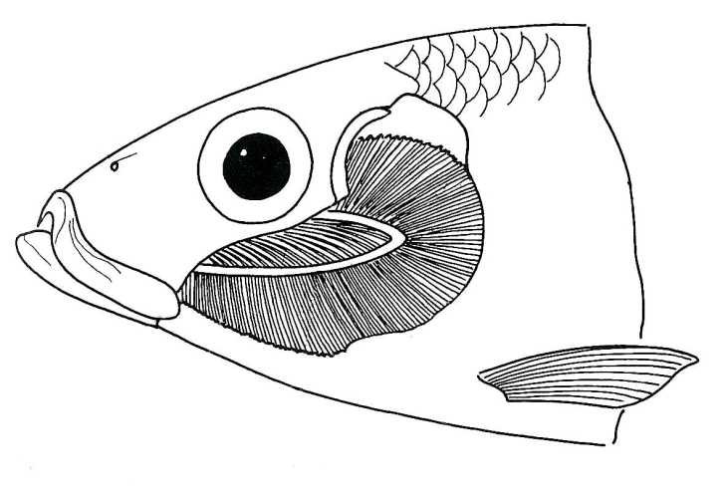
Physiology of Respiration
Fish use organs called gills to breathe.
Water is drawn through the mouth by constant opening and closing of the mouth.
This forces water into the pharynx and out through gills.

Slide 58
Physiology of Respiration
Dissolved oxygen in water is taken into the blood and CO₂ is released into the water from the gills.

Slide 59
Physiology of Respiration
A few species of fish come to the surface and gulp air into their mouth. They are able to use atmospheric oxygen because part of their intestines allow for intake of oxygen. The air is then swallowed into the digestive system and taken into the blood.

Slide 60
Physiology of Movement
Fins-a moveable structure that allow the fish to swim and maintain balance.
Most bony fish have rayed fins that consist of webs of skin supported by bone or cartilage rods called rays.
Rays can be sharp, soft, or spiny.
Fins are very flexible.

Slide 61
Physiology of Movement
Most fish have at least one fin along their back (dorsal), one underside near the tail (anal), and one tail fin (caudal).
Some have a small fleshy fin located between the dorsal and caudal called an adipose fin.
Fish also have a pair of fins located behind the head called the pectoral and the pelvic located behind them.

Slide 62
Physiology of Amphibians
Cold blooded animals that have thin, moist skin that allows them to breathe through the skin by osmosis.
Amphibians usually live in moist environments, but location usually depends on their skin thickness.
Amphibians do not have scales.

Slide 63
Physiology of Amphibians
Amphibians crush their prey and swallow it whole because they do not have teeth.
They also live part of their life in water. Adult amphibians spend part or all of their life on land.

Slide 64
Physiology of Reptiles
Reptiles are cold blooded vertebrates that have dry, scaly skin and lungs for breathing.
Reptiles have bony skeleton scales or horny plates that cover their body.
Reptiles include crocodiles, lizards, snakes, turtles, tortoises, etc.

Slide 65
Physiology of Reptiles
Some give birth by laying eggs (oviparous), others retain the eggs in their body until they hatch and give birth to young (ovoviviparous), and in others their young develop in a placental sac and are born live (viviparous).

