Slide 1
Objective 10.02
Use care techniques that improve the well-being of fish, amphibians and reptiles.

Slide 2
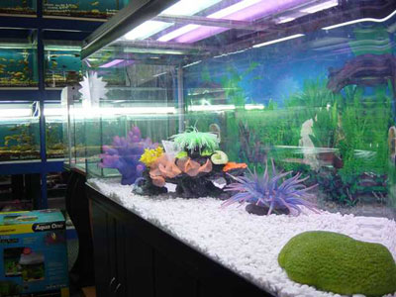
Purchasing an Aquarium
Decide on tank type (glass or plastic)
Plastic is cheaper, but glass is easier to clean.
Framed tanks are more expensive than all glass and offer more support to the glass.

Slide 3
Purchasing an Aquarium
Tank size
Size depends on the amount you want to invest and the type (species) of fish.
Ranges from a simple Beta or goldfish bowl with a 1 gallon capacity to 10, 30, 50, or 100+ gallons.
Thickness of glass ranges from ¼” for small aquariums to 3/8” for larger aquariums.

Slide 4
Purchasing an Aquarium
Stocking Rate for Aquariums
1 inch of fish requires a MINIMUM of:
Tropical fish aquarium | 10 in² of surface area
Cold water aquarium | 30 in² of surface area
Marine aquarium | 48 in² of surface area

Slide 5
Purchasing an Aquarium
For example:
An aquarium that is 24” long by 10” wide has 240 in² of surface area.
The tank would hold 24” of tropical fish, 8” of cold water fish, or 5” of marine fish.
One could have eight swordtails 3” long in a tropical aquarium, two goldfish 4” long in a coldwater aquarium, or two Brasslets 2.5” long in a marine aquarium.

Slide 6
Purchasing an Aquarium
Shape
Depends on personal preference and species of fish you are raising.
The most common shape is rectangular, but square, spherical, etc are also common.

Slide 7
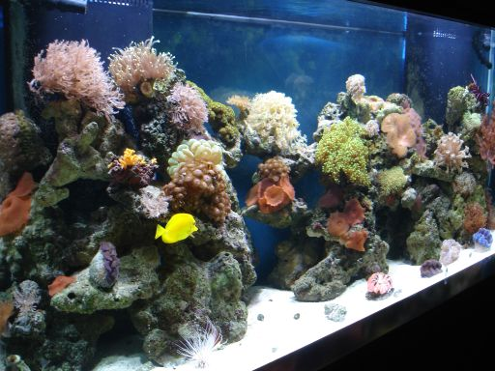
Purchasing an Aquarium
Species
Type of fish purchasing
Freshwater vs. saltwater

Slide 8
Aquarium Equipment
Power filter with an electric motor
Filtration systems remove uneaten food materials, dissolved materials, solid waste and neutralize harmful substances.

Slide 9
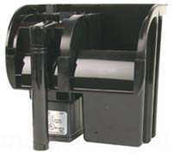
Types of Filtration Systems
Mechanical
Removal of waste by using various kinds of filtration devices
Modern systems use an external filter box

Slide 10
Types of Filtration Systems
Chemical
Removal of dissolved material by using a chemical process
The use of activated charcoal to soak up dissolved minerals and chemicals is the most common chemical removal process.
Activated charcoal is often part of the filter system and must be changed at regular intervals.

Slide 11
Types of Filtration Systems
Biological
Use bacteria to feed on toxic substances such as ammonia excreted from fish during respiration or as a result of decaying waste and food material.
Waste is changed from a harmful substance to a harmless one (nitrogen)
Dissolved oxygen in the water is also replenished.

Slide 12
Aquarium Equipment
Air Pumps for aeration
Water is circulated from the bottom of the tank to the surface where aeration can take place.
Compressed air (oxygen) is pumped through airstones (fused, porous glass) to break the airflow into minute bubbles.

Slide 13
Aquarium Equipment
Air Pumps Cont’d
As the compressed air goes into the water, it disperses carbon dioxide (aeration)
Air bubbles rising from the bottom aid in equalizing the water temperature throughout and circulating the water to the top where aeration can take place.

Slide 14
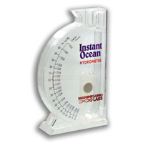
Aquarium Equipment
Hydrometer
For measuring salt content
GFCI electrical outlet preferred

Slide 15
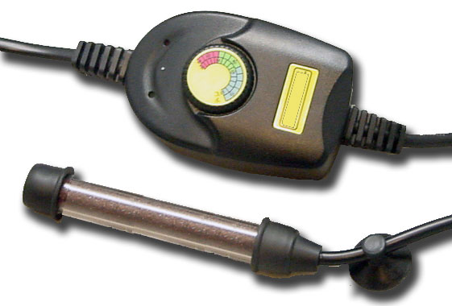
Aquarium Equipment
Heater/Thermostat
Needed to maintain water temperature for tropical aquariums
Must be the right size (approximately 10 watts of power for each 1 ½ gallons of water

Slide 16
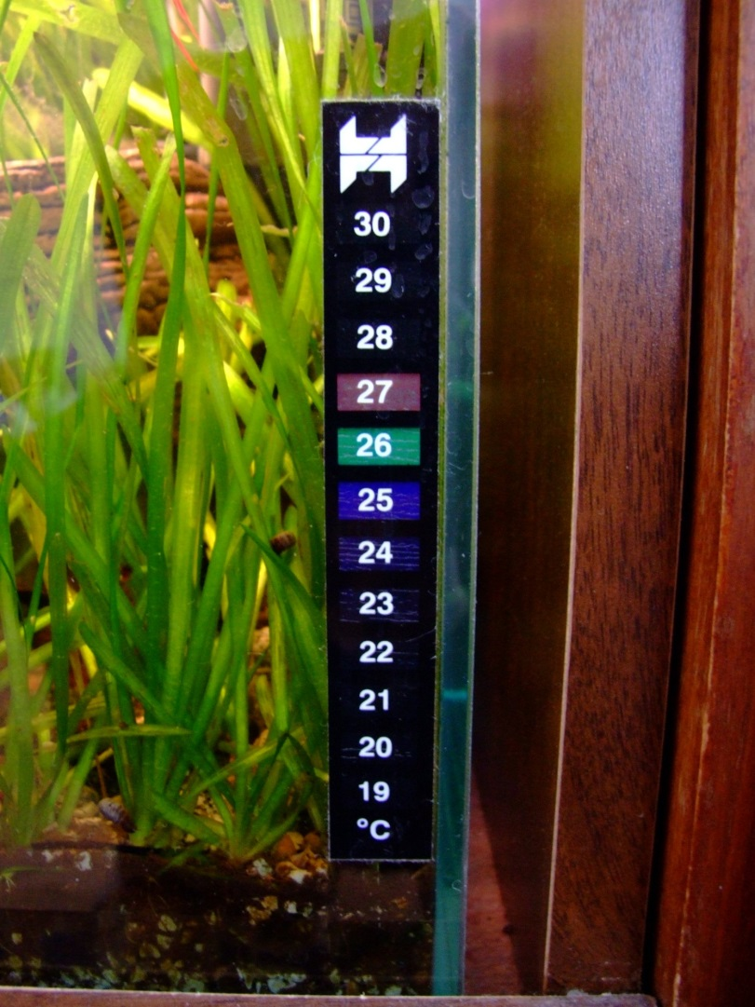
Aquarium Equipment
Thermometer
Liquid crystal thermometers that are adhesive strips that stick to the outside of the aquarium are popular

Slide 17
Aquarium Equipment
Other materials
Water container (for exchanging water)
Gravel or sand
Plants
Decorative stones
Hood with starter for fluorescent lights
Dip nets
Decorative materials

Slide 18
Aquarium Maintenance
Remove temporary hardness of water by boiling and allowing to sit prior to its use in the aquarium
Eliminate chlorine by aerating it for 12-24 hours prior to use or allowing it to sit for 48 hours so the chlorine will evaporate.

Slide 19
Aquarium Maintenance
Daily Maintenance
Check heater, temperature, aeration, and filtration
Remove dead fish
Observe for any unusual behavior

Slide 20
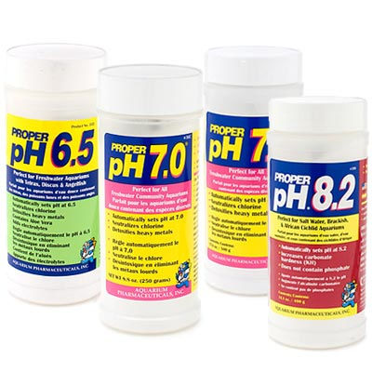
Aquarium Maintenance
Weekly Maintenance
Check water level and pH and add water and chemicals as appropriate

Slide 21
Aquarium Maintenance
Monthly Maintenance
1/4 to 1/5 of the water needs to be changed every three to four weeks to provide fish a stress free environment and prolong the life of the filters
Siphon off any dead material from bottom of the aquarium.
Tend to plants and remove algae.

Slide 22
Aquarium Maintenance
Factors that contribute to increased ammonia and nitrates in the tank
Increase in waste material and uneaten food on the bottom (Don’t overfeed)
Dirty filters and failure to change water monthly
Overpopulation of fish

Slide 23
Feeding Fish
Vary feed to prevent boredom—fish really like live food, but freeze-dried and frozen food is a good alternative
Feed fish 2 to 3 times per day
Feed only enough for the fish to eat in 3-5 minutes.
Live foods like brine shrimp, earthworms, wood lice, and worms are treats to fish.

Slide 24
Feeding Fish
Commercially prepared flake foods are ideal for small fish up to 4-5” long. Vitamins and nutrients are provided in amounts needed by the fish.
Commercially prepared pellets work well for larger fish. The type depends on the eating habit of the fish being kept.

Slide 25
Reptile and Amphibian Habitats
Vast differences between species, but the goal should always be to duplicate the natural environment of the pet.
Aquariums usually make the best containers.
Semi-aquatic aquariums may be made by using plexi-glass to partition the aquarium in half

Slide 26
Reptile and Amphibian Habitats
Vivariums should be designed to give the reptile an environment close to its actual habitat.
Reptiles are ectotherms. They do not generate body heat and must rely completely on the temperature of their environement.

Slide 27
Reptile and Amphibian Habitats
Reptiles need ultraviolet (UV) rays for calcium metabolism, formation of pigment, and vitamin D synthesis.
Reptiles need sunlight.
Fluorescent lights will provide UV rays as long as there is not glass between the light and the reptile. Glass filters the UV rays out.

