Slide 1
Animal Science II-Small Animal
Dogs- Unit D

Slide 2
Essential Standard 7.00
Use information specific to each breed to select to select the best dog for a given use.

Slide 3
Objective 7.01
Discuss the major breeds of dogs.

Slide 4
Seven Major Groups of Dogs
Sporting
Hounds
Terriers
Working
Herding
Toy
Non-Sporting
Jack Russell Terrier (not included)
Parson Russell Terrier according to the AKC

Slide 5
Sporting
Developed to hunt game
Pointers
Setters (Irish Setter)
Spaniels
Retrievers

Slide 6
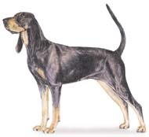
Hound
Hunting and tracking by scent and sight
Basset
Bloodhound
Dachshund
Greyhound
Beagles

Slide 7
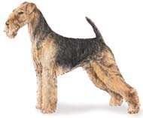
Terrier
Hunt under ground
Terriers
Schnauzers

Slide 8
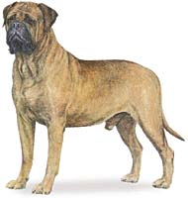
Working
Developed to perform services
Pulling sleds, protecting property, and provide human protection, guarding property
Doberman Pinscher
Great Dane
Saint Bernard
Siberian Husky

Slide 9
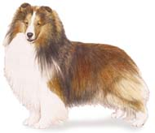
Herding
Developed to assist in managing livestock
Collie
German Shepherd
Old English Sheepdog

Slide 10
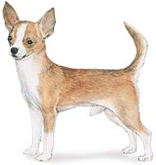
Toy
Developed to be small (4-16 lbs) for house pets and companion animals
Chihuahua
Pekingese
Pug
Toy Poodles

Slide 11
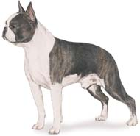
Non-sporting
Miscellaneous class used mainly for companionship
Boston Terrier
Bulldog
Dalmatian
Poodle

Slide 12
Sporting
Twenty-four breeds make up the sporting group

Slide 13
Sporting
Pointers
Dogs developed about 200 years ago from England
Named from the stance they take when finding game
Colored liver, lemon, black, orange in combination with white or solid color
Less coat care due to shorthair
Even temperament
Affectionate
Intelligent
Patient with children

Slide 14
Pointer

Slide 15
Sporting
Irish Setter
Noted for its solid red color, speed, loyalty, boldness, and toughness
Mahogany or rich chestnut red with no trace of black in the coat color
Slightly taller and heavier than English setters
Used for all types of game, but train slower than some other breeds
Ideal show dog, but it can’t be used for both show and field.

Slide 16
Irish Setter

Slide 17
Sporting
American Cocker Spaniels
Smallest members of the sporting dog family
Sandy color with elegant appearance and cheerful disposition
Soft-hearted dog that makes an excellent family pet

Slide 18
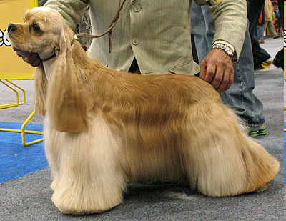
American Cocker Spaniel

Slide 19
Sporting
Labrador Retrievers
Active water dog that was bred to get downed waterfowl
Short coupled, strongly built dog with an alert, friendly disposition, fine temperament, and inquisitive nature
Very dependable
One of the best used breeds for guide dogs or for search and rescue work
Short, thick, water-resistant hair
Colors of black, chocolate, or yellow (golden).
Usually not as tall as pointers

Slide 20
Labrador Retriever

Slide 21
Other Sporting Breeds
Brittany Spaniel
Chesapeake Bay Retriever
Clumber Spaniel
English Cocker Spaniel
German Shorthaired Pointer
German Wirehaired Pointer
Golden Retriever
Gordon Setter
Springer Spaniel
Weimaraner

Slide 22
The Hounds
Hunts by scent or by sight
The greyhound and Alghan hound hunt by sight, while most others hunt by smell

Slide 23
The Hounds
Basset hound
Excellent sense of smell
Short-legged dog heavier in bone than any other breed for its size
Gentle, devoted dogs that are good with children, but may be stubborn and difficult to house break
Usually white with chestnut or sand-colored
Not exceeding 14“ in height
Weighs 40 to 51 lbs on average

Slide 24
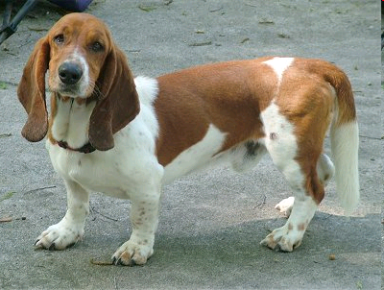
Basset Hound

Slide 25
The Hounds
Beagles
Noted for their rabbit hunting ability
Make great pets and companions
Weight and Height
18 - 30 lbs
13 - 15" height at the shoulder
Colors range from a blue with black tigering, white, black, orange, or hound type tri-coloring

Slide 26
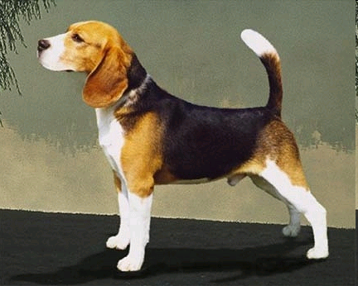
Beagle

Slide 27
The Hounds
Bloodhounds
One of the most docile of all breeds
Can track a scent that is several hours old
Disposition:
Affectionate, but somewhat shy
Non aggressive
Sensitive to correction and kindness
Excellent pets for children
Colors range from tawny to black and tan or red and tan
Largest of the hound group

Slide 28
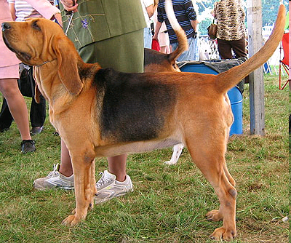
Bloodhound

Slide 29
The Hounds
Greyhounds
Favorites of Egyptian royalty
Greyhounds are good at hunting all types of game
Because of its speed, they were used in packs to catch their quarry and pull it down
Used in the United States for racing
Valuable as a show dog
Need lots of exercise
Not suited for apartment dwelling
Not recommended as a companion dog for children

Slide 30
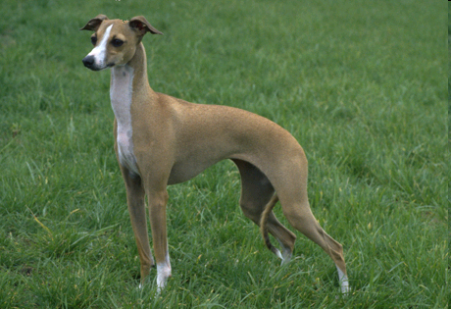
Greyhound

Slide 31
Other Hound Breeds
Afghan Hound
American Foxhound
Black and Tan Coonhound
Dachshund
Norwegian Elkhound

Slide 32
The Terrier Group
Developed to hunt “underground”
Its name is derived from the Latin word terra meaning earth
Two subgroups:
long legged
short legged

Slide 33
The Terrier Group
Fox Terrier
Either smooth or wired, depending on the type of hair coat
White should be the dominant color
One of the Best known and most widely distributed purebred dogs
Noted for their courage in hunting animals that den in the ground
Fox terriers are easy to train
Affectionate
Good companion dogs

Slide 34
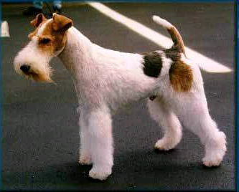
Fox Terrier

Slide 35
The Terrier Group
Miniature Schnauzer
German breed developed to hunt badger, fox, weasel, etc.
Good apartment dog
Fond of children
Intelligent, hardy and healthy
Less than 20 pounds
12 – 14" in height at the shoulder
Stocky
Wirehaired

Slide 36
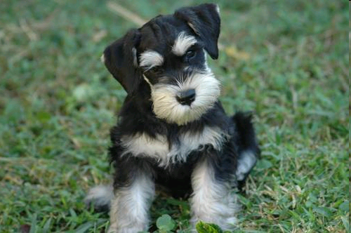
Miniature Schnauzer

Slide 37
The Terrier Group
Parson Russell Terrier
Recognized by the American Kennel Club as part of the Terrier group
This dog was formerly the Jack Russell Terrier
Recognized in other nations as a separate breed
See the Jack Russell Terrier for a description

Slide 38
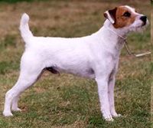
Parson Russell Terrier

Slide 39
Other Terrier Breeds
Airdale Terrier
Bedlington Terrier
Border Terrier
Bull Terrier
Skye Terrier
Welsh Terrier

Slide 40
Working Dogs
Perform a service to humans
Pulling sleds
Protecting property
Performing rescue work
Carrying messages

Slide 41
Working Dogs
Great Dane
One of two largest breeds of dogs
Friendly companion or watchdog.
Weight
110-115 lbs for females
120-150 lbs for males
Height at the shoulder
> 28" for females
> 30" for males

Slide 42
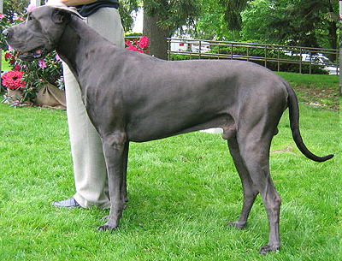
Great Dane

Slide 43
Working Dogs
Saint Bernards
One of the two largest breeds
Excellent sense of smell
Coat made it suitable to perform rescue in extreme mountain climate conditions
Peaceful, quiet, and gentle dog
Loves the company of humans
Makes a good companion dog
Color
Red with white markings or white with red markings

Slide 44
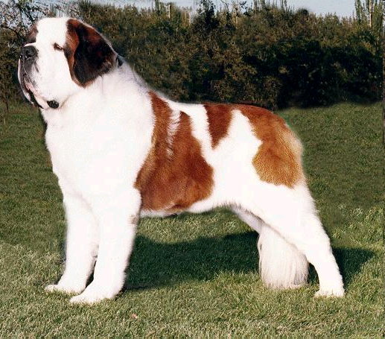
Saint Bernard

Slide 45
Working Dogs
Siberian Husky
Originated in Asia
Endurance sled dog
Found its home in Alaska
Began to win the All Alaska Sweepstakes Race in the early 1900’s
Friendly and gentle dog
May be stubborn and ill around children
Not aggressiveness or protective
Poor watchdog
Color
Pure white to all other colors including black

Slide 46
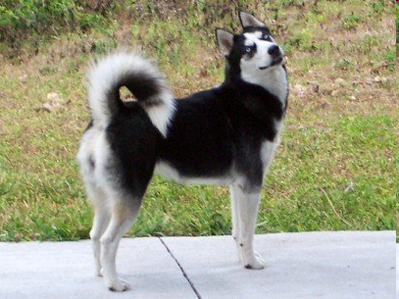
Siberian Husky

Slide 47
Other Working Breeds
Alaskan malamute
Boxer
Doberman Pinscher
Great Pyrenees
Mastiff
Standard Schnauzer
Rottweiler
Samoyed

Slide 48
Herding Dogs
Developed to assist the herdsman manage various livestock species

Slide 49
Herding Dogs
Collies
One of the older breeds
Used for sheepherding
Used mainly today as:
devoted family dogs
wary of strangers
very protective
Either rough-coated (longhaired) or smooth coated
long-haired collie require frequent brushing to remove burrs and knotted hair
Color: Sable and white, Tricolored, Blue and merle, and white

Slide 50
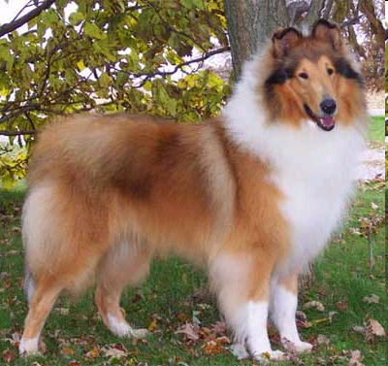
Collie

Slide 51
Herding Dogs
German Shepherd
Probably crossed between herding dogs & wolves
Rescue dogs, police dogs, guard dogs, guide dogs, and pets
Courageous, loyal, obedient, and affectionate to family members
Leery of strangers
Color
Black nose with various shades of gray, brown, and yellow

Slide 52
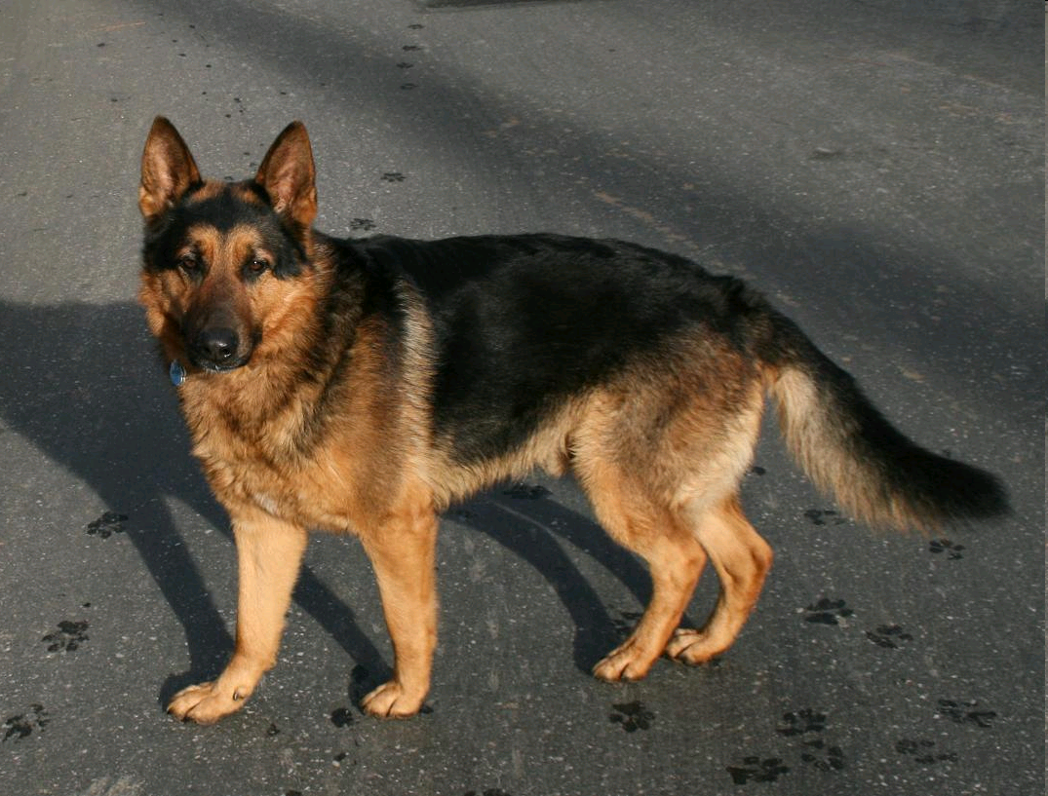
German Shepherd

Slide 53
Herding Dogs
Shetland sheepdog
Small version of the collie
Excellent family pets and companion dogs
Docile
Devoted dog
Intelligent
Color
Black, blue merle, and sable with markings of white and/or tan

Slide 54
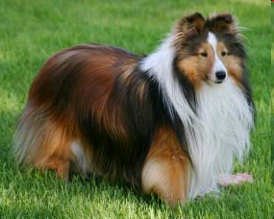
Shetland Sheepdog

Slide 55
Other Herding Breeds
Old English Sheepdog
Welsh Corgi

Slide 56
Toys
So-named because of their small size
Most often used as house pets and companions

Slide 57
Toys
Chihuahua
Named for the state of Chihuahua in Mexico
Smallest breed of dog in the world
Oldest breed on the continent
Noted as a clannish breed
Does not like other breeds of dogs
Courageous, energetic, lively, alert, and intelligent

Slide 58
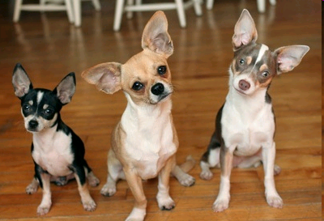
Chihuahua

Slide 59
Toys
Pekingese
From China
Extremely affectionate with its owner
Make good watchdogs or lapdogs for apartment dwellers
Will show great courage
Not afraid of larger adversaries
Require teeth care to prevent decay
Needs frequent coat care to keep its long, fine hair well groomed

Slide 60
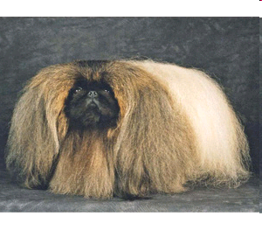
Pekingese

Slide 61
Toys
Shih Tzu
Chinese breed with a long, flowing hair coat
Requires constant care to prevent matting and knotting
Color
Eyes and nose are rim black with any coat color
Looks like a miniature lion
Has an aristocratic, arrogant carriage

Slide 62
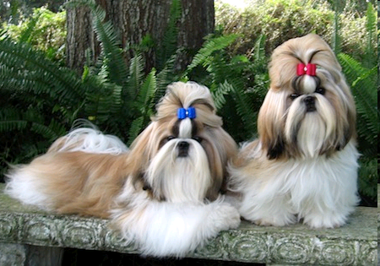
Shih Tzu

Slide 63
Other Toy Breeds
Italian Greyhound
Manchester Terrier
Pug

Slide 64
Non-sporting
Miscellaneous breeds
Used mainly for companion dogs

Slide 65
Non-sporting
Boston Terrier
American breed
Originated from crossing the English Bulldog and white English Terrier and further developed though inbreeding
Clean cut dog
Has the body conformation of a Terrier
Make excellent house dogs or companion dogs
Even tempered, intelligent, and get along well with children
Color:
Black or Brindle with white markings

Slide 66
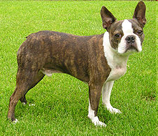
Boston Terrier

Slide 67
Non-sporting
Dalmatian
Calm, quiet dog
Intelligent
Has been used as a trail hound for tracking, for hunting birds, boar, and bear, retrieving game
Most notably used as a coach or carriage dog (fire trucks)
Will follow their master if at all possible regardless of the mode of the master’s travel
Thrives on human companionship
Natural as guardians
Love children
Color
White with black spots or white with liver brown spots

Slide 68
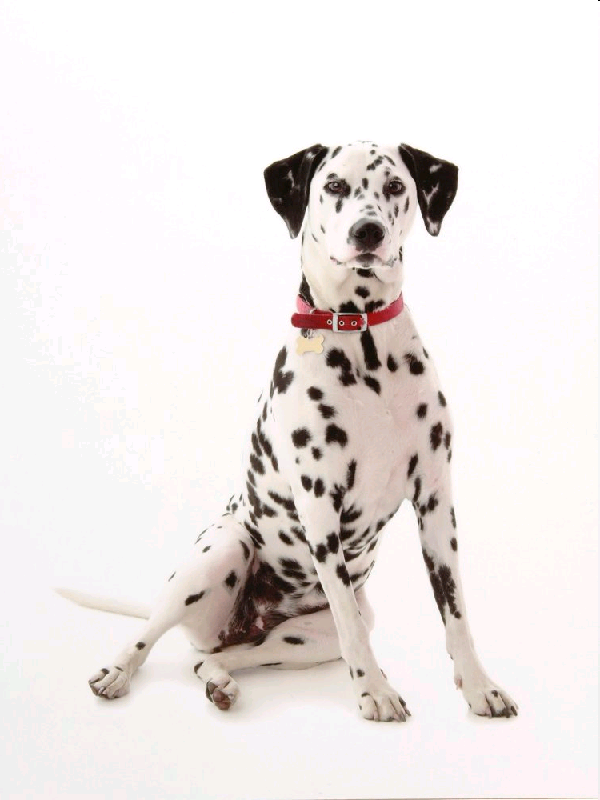
Dalmatian

Slide 69
Non-sporting
Poodle
Very intelligent
Good natured dog (usually)
Known as the national dog of France
Used as a retriever, duck(water) dog, and circus trick dog
Used today as companion and show dogs
All colors with an even and solid coat color at the skin
Weight
Standards average 35 - 45 pounds for females and 40 – 50 pounds for males
Miniature varieties average 16 - 35 pounds for females and 18 – 30 pounds for males
Toy Poodles average 14 - 16 pounds for females and 15 – 18 pounds for males
Height at the shoulder
Standards are >15"
Miniature varieties average 10 – 15"
Toy Poodles are < 10"

Slide 70
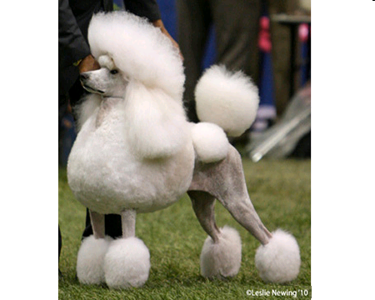
Poodle

Slide 71
Other Non-Sporting Breeds
Bulldog
Lhasa Apso
Chow Chow

