Slide 1
Dog Diseases
Small Animal Care

Slide 2
Dog diseases
Infectious diseases
Caused by pathogenic microorganisms

Slide 3
Canine Distemper
Caused by inhalation of airborne virus
Early vomiting and diarrhea
Later:
tremor-epileptic fits

Slide 4
Canine Parvovirus Infection
Virus
Contaminated feces
Mostly affects young pups
Symptoms
vomiting
bloody diarrhea
refusal to eat

Slide 5
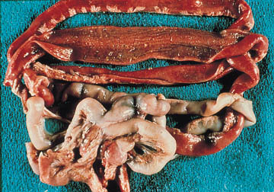
Canine Parvovirus
http://www.petservice.com/libraries/pictures/parvo_pict.html

Slide 6
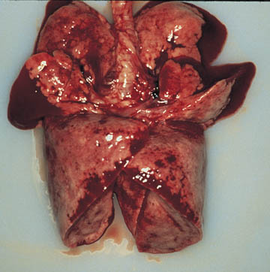
Kennel Cough (tracheobronchitis)
Respiratory disease
Contracted in confinement
pet shops
dog shows
kennels
Symptom: cough
http://www.petservice.com/libraries/pictures/bord_pict.html

Slide 7
Rabies
Viral disease
Attacks the central nervous system
All warm-blooded animals can transmit rabies
Symptoms:
Occur 2 weeks to 3 months after bite
Severe can be within 10 days

Slide 8
Rabies
“Furious” rabies
act strange then wander off
attack and bite anything
frothing at the mouth
“Dumb” rabies
no wandering but paralysis of lower jaw
followed by paralysis of body and death

Slide 9
Infectious dog diseases
Canine Brucellosis
Bacterial disease
Causes abortion
Failure to whelp
Enlargement of the lymph nodes
Swelling of the scrotum and testicles

Slide 10
Infectious dog diseases
Salmonellosis
bacterial disease
ingestion of food contaminated with feces

Slide 11
Noninfectious
Heart disease
Symptoms:
coughing at night during sleep
coughing during exercise
open mouth breathing at rest
Congenital (birth)
Contracted

Slide 12
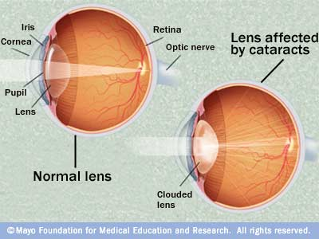
Noninfectious
Cataracts
cloudy, white opacity of lens
can be hereditary or not
can cause blindness
found mostly in older dogs

Slide 13
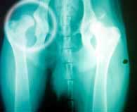
Noninfectious
Hip Dysplasia (CHD)
Inherited trait
Environmental conditions
too much exercise
rough play
excessive weight gain
rapid growth
Affects the hip joints and is common in large breeds
http://www.belfield.com/xray2.jpg

Slide 14
Noninfectious
Arthritis
Degenerative joint disease
pain
lameness
stiffness in the joints
Large, old, and obese dogs are more prone to the disease

Slide 15
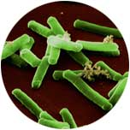
Noninfectious
Tetanus
Caused by a bacteria
spores are present in the soil and feces of various animals
produces toxins
over stimulation of the dog’s nervous system
Symptoms
spasms of facial muscles
Paralysis
Lockjaw
inability to stand
prolapse of the third eyelid

Slide 16
Fungal diseases
Ringworm
Most common fungal disease
Symptoms
begin as broken hairs around the face ears, or feet
reddened and scaly skin
crusting and scaling in severe cases

Slide 17
Fungal diseases
Blastomycosis
inhaling infected spores of soil enriched with bird or bat droppings
Symptoms:
coughing
rapid breathing
pneumonia and fever

Slide 18
Internal Parasites
Ascarids
Roundworms that may grow to 8” in length
Affect mainly puppies
deprive them of nutrients
Severe infestation will cause a pot-bellied appearance
Transmitted by female dogs to puppies
Danger to children

Slide 19
Internal parasites-
Hookworms
Blood sucking parasites
Adult worms are about 1” long
Attach to the small intestine
causing small spots of bleeding
can cause severe loss of blood into the intestine
anemia
Affects all ages of dogs

Slide 20
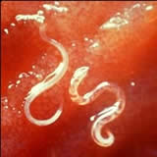
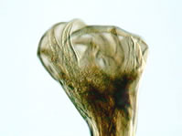
Hookworms
http://www.bullwrinkle.com/ShoppingPages/dog-hookworms.htm

Slide 21
Internal Parasites
Whipworms
Broad at one end and narrow at the other
They use the narrow end to attach to the cecum and lower digestive tract
Adults are about 2 ½” long
produce “shell” protected eggs
may live in the soil for years
Produce watery feces
May result in dehydration and death if untreated

Slide 22
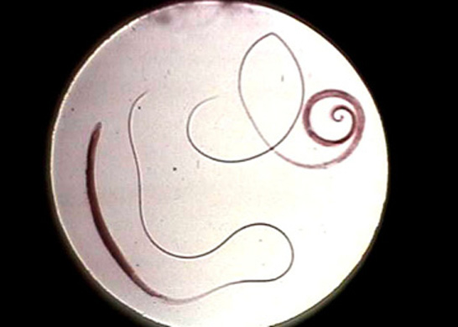
Whipworms
http://www.beaglesunlimited.com/Photos/CanineWhipworms.jpg

Slide 23
Internal Parasites
Tapeworms
Usually the largest worms affecting dogs
1’ or more in length
Most depend on a host such as a flea or wild rabbit
Flat and segmented
small intestine
shed terminal segments in feces
Not harmful for dogs but may cause serious injury to humans

Slide 24
Internal Parasites
Heartworms
Thin worms that grow to a length of 14”
live in the major artery carrying blood from the heart to the lungs
Serious threat to dogs
Major injury to vital organs
Symptoms:
frequent coughing
labored breathing
fainting
Transmitted by mosquitoes
Prevention is preferred to treatment
treatment must occur early

Slide 25
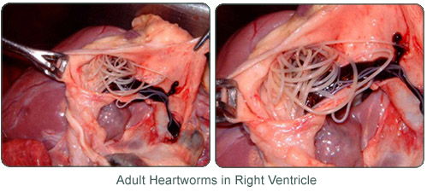
Heartworms
http://www.shakervet.com/heartworm.html

Slide 26
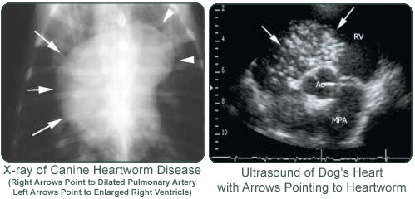
Heartworms
http://www.shakervet.com/heartworm.html

Slide 27
External Parasites
Fleas
Small blood sucking insects
move rapidly over the skin
Develop from eggs to adult in as little as 16 days
first detected in the groin and rump area
cause irritation and extreme itching
Controlled with powders, dips, shampoos, collars, oral insecticides, foggers and sprays

Slide 28
External Parasites
Ticks
Blood sucking arthropods
Two main families
Hard tick
Brown dog tick can survive indoors
American dog tick lives in grass and on shrubs
Soft tick
Spirose Ear tick
larvae and nymph stage live in and cause irritation to the outer ear canal

Slide 29
External Parasites
Lice
Wingless insects
Bloodsuckers
Not common on dogs
Severe hair loss from scratching and rubbing
Two treatments 12 days apart with dips, dusts, or sprays

Slide 30
External Parasites
Mites
Tiny, eight legged arachnids
Demodectic mites do not usually cause problems, but a severe infestation may result in hair loss, reddening of skin, and encrusting either in spots or over the entire body

Slide 31
External Parasites
Two types of Sarcoptic mites
Burrow within the outer layer of skin
highly contagious
mange or scabies
intense irritation and itching may result in the dog injuring itself as it tries to scratch, chew or rub the skin

Slide 32
External Parasites
Ear mites
Highly contagious
Outer ear canal
They are a common problem with infected animals shaking their head
Flea products are effective in treatment as well as ear drops

Slide 33
External Parasites
Cheyletiella mites
Contagious
Cause a condition known as “walking dandruff”
Severe scaling on the back may occur
Itching is not as severe as with other mite infestations

Slide 34
External Parasites
Chiggers
Orange-red larvae stages of Trombicula mites
cause an itchy, red rash on the belly, face and legs
Picked up from underbrush
Remain on the skin for a short time
Usually do not require treatment other than something to stop the itching

Slide 35
Poisons
Insecticides
May cause poisoning if ingested in large anounts
Organophosphates and carbamate compounds
Main source of insecticidal poisoning
Boric acid from roach bait
Arsenic from ant traps

Slide 36
Poisons
Herbicides
Glyphosphate
Round-Up
Arsenic-based weed killers

Slide 37
Poisons
Plants
Philodendron
Dieffenbachia (Dumbcane)
Mouth swells to the point that you can not talk
Pothos
Caladium
contain insoluble calcium oxadate crystals
cause irritation to the mouth and intestinal tract

Slide 38
Dieffenbachia

Slide 39
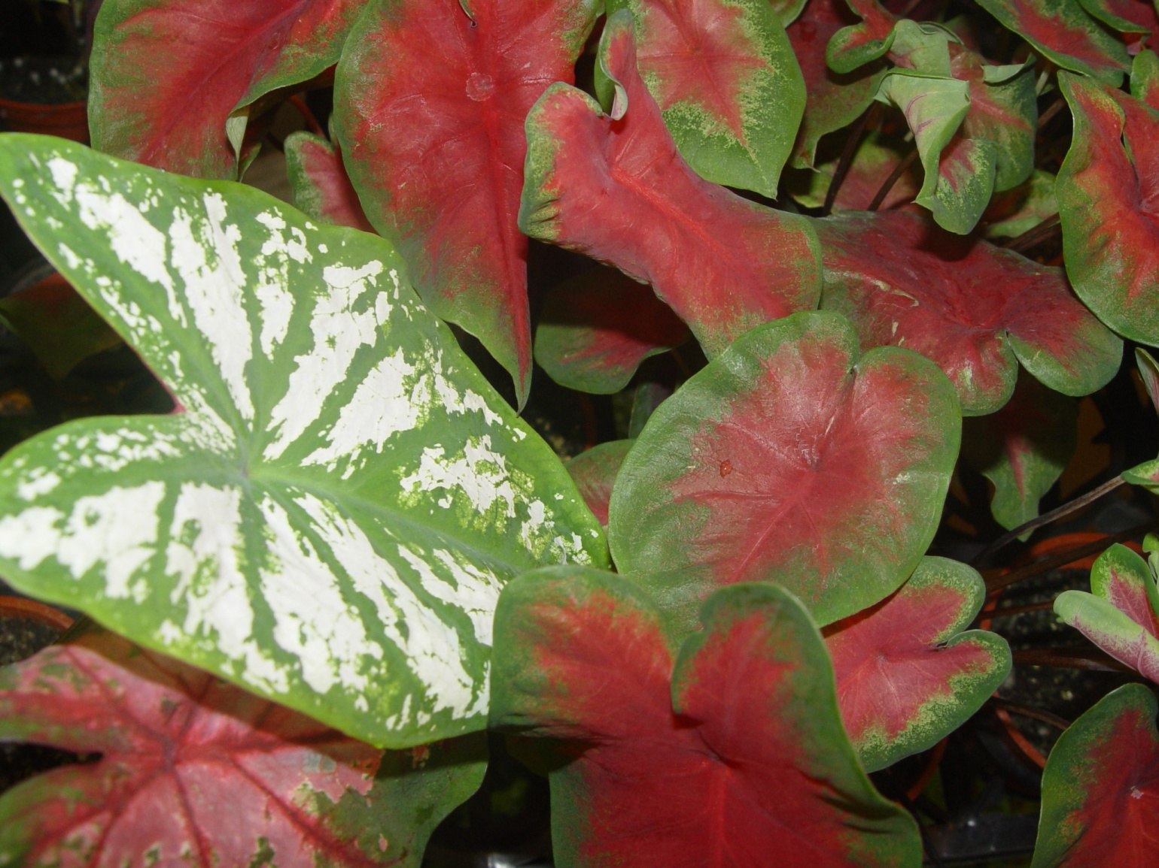
Caladium

Slide 40
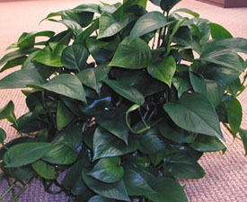
Philodendron

Slide 41
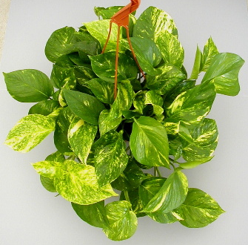
Pothos

Slide 42
Poisons
Household chemicals and cleaners
Can cause sickness if ingested
Ammonia
Bleach
Borates
Hydroxides
Pine oil

Slide 43
Poisons
Rodenticides
Used for rodent control
Strychnine & warfarin
internal bleeding
death if ingested in sufficient quantities

Slide 44
Poisons
Antifreeze
Common source
Sugary taste
Symptoms:
Appear drunk
Depressed

