Slide 1
Herding Group
Animal Science 2- Small Animals

Slide 2
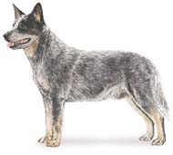
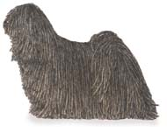
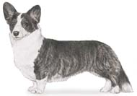
Herding Group
Developed to assist the herdsman manage various livestock species
Cardigan Welsh Corgi
Puli
Australian Cattle Dog

Slide 3
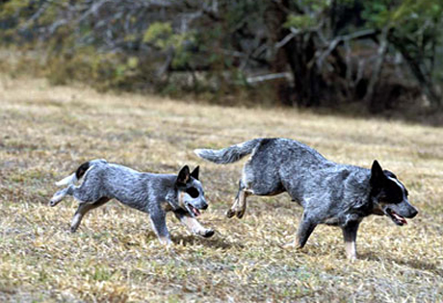
Australian Cattle Dogs
Aka: Blue Heeler
Happiest in wide open spaces
High-energy dogs and extremely intelligent
Need a job - such as herding, obedience or agility - to keep them happy

Slide 4
Australian Cattle Dogs
http://animal.discovery.com/tv-shows/dogs-101/videos/australian-cattle-dog.htm

Slide 5
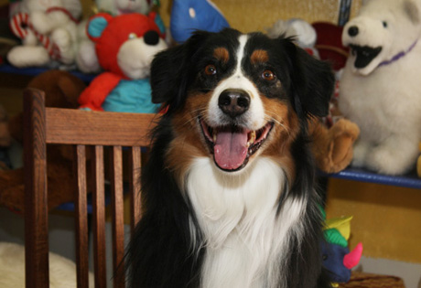
Australian Shepherds
An energetic breed with strong herding and guarding instincts, the Aussie requires daily vigorous exercise
Excellent family dog, although it will try to herd children as well!

Slide 6
Australian Shepherds
http://animal.discovery.com/tv-shows/dogs-101/videos/australian-shepherd.htm

Slide 7
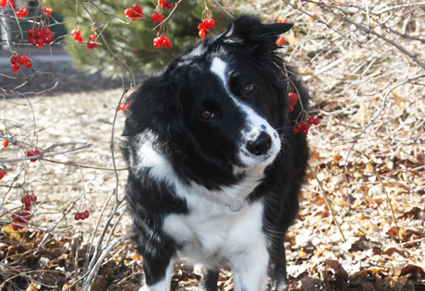
Border Collie
They thrive when they have a job to do and space to run.
Due to their tendency to herd objects and people, they do best with mature, well-behaved children

Slide 8
Border Collie
http://animal.discovery.com/tv-shows/dogs-101/videos/border-collie.htm

Slide 9
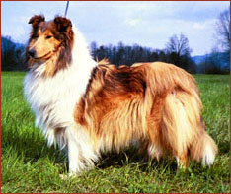
Collies
One of the older breeds and were used for sheepherding
http://www.androma-collies.com/pictures/present_tessa.jpg

Slide 10
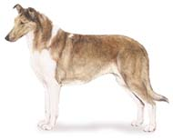
Collies
Used mainly today as pets and are devoted family dogs that are wary of strangers and very protective of their owner and family
Either rough-coated (longhaired) or smooth coated, with the longhaired collie requiring frequent brushing to remove burrs and knotted hair
Color: Sable and white, tri-colored, blue and merle, and white

Slide 11
Collies
http://animal.discovery.com/tv-shows/dogs-101/videos/collie.htm

Slide 12
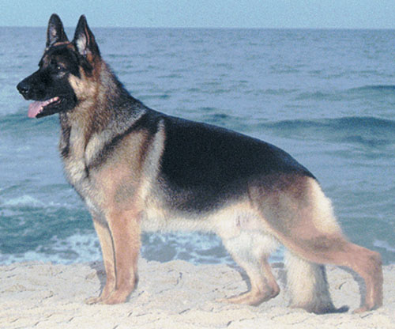
German Shepherd
May have been crossed between herding dogs and wolves; their uses today include rescue dogs, police dogs, guard dogs, guide dogs, and pets
http://www.dognews.com/pedigreegallery/herding/images/GERMAN%20SHEPHERD%20.jpg

Slide 13
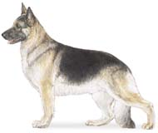
German Shepherd
Courageous, loyal, obedient, and affectionate to family members, but leery of strangers
Color: Black nose with various shades of gray, brown, and yellow

Slide 14
German Shepherd
http://animal.discovery.com/tv-shows/dogs-101/videos/german-shepherd.htm

Slide 15
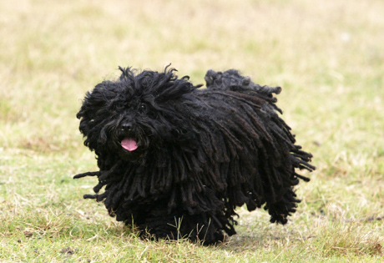
Puli
Intelligent and possessing an excellent sense of humor, Pulis retain their "puppy" attitude nearly their entire lives. The breed loves their family and home, and as such, is naturally protective and suspicious of strangers.

Slide 16
Puli
http://animal.discovery.com/tv-shows/dogs-101/videos/puli.htm

Slide 17
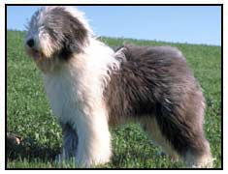
Old English Sheepdog
Large, muscular dog that has a gait that makes it look like a bear when it moves
http://www.thepetprofessor.com/breeds/images/Old-English-Sheepdog-picture.jpg

Slide 18
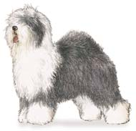
Old English Sheepdog
Excellent herd dogs, companion dogs, and pets, and have also been used for guard dogs, sled dogs, and retrievers
They are friendly and affectionate

Slide 19
Old English Sheepdog
http://animal.discovery.com/tv-shows/dogs-101/videos/olde-english-sheepdog.htm

Slide 20
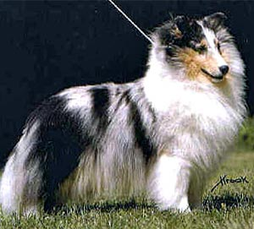
Shetland Sheepdog
Basically a small version of the collie that are excellent family pets and companion dogs
http://www.westminsterkennelclub.org/breedinformation/herding/images/shetshee.jpg

Slide 21
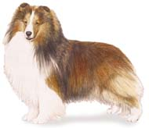
Shetland Sheepdog
Noted for being docile, devoted dog that is very intelligent
Color: Miniature collie with black, blue merle, and sable with markings of white and/or tan

Slide 22
Shetland Sheepdog
http://animal.discovery.com/tv-shows/dogs-101/videos/shetland-sheepdog.htm

