Slide 1
Terrier Group
Animal Science 2- Small Animals

Slide 2
Terrier Group
Developed to hunt “underground.”
Its name is derived from the Latin word terra meaning earth
There are two subgroups:
the long legged and short legged

Slide 3
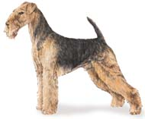
Airedale Terriers
In the large long-legged group
Head and ears are tan with the sides and upper parts of the body being black or grizzle
Very docile, obedient dog that gets along well with children

Slide 4
Airedale Terriers
http://animal.discovery.com/tv-shows/dogs-101/videos/airedale-terrier.htm

Slide 5
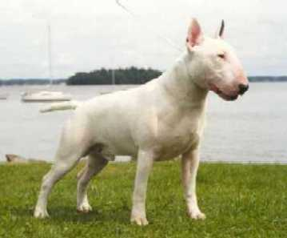
Bull Terriers
A cross of the Bulldog, Old English Terrier, and Spanish Pointer that were used for dogfights
http://petcaretips.net/bull_terrier.jpg

Slide 6
Bull Terriers
May be loving and affectionate, but they will readily fight to protect themselves or their master
Color is white (may have some black markings about the head) or colored. Colored bull terriers are any color but white, with brindle being the preferred color

Slide 7
Bull Terriers
http://animal.discovery.com/tv-shows/dogs-101/videos/bull-terrier.htm

Slide 8
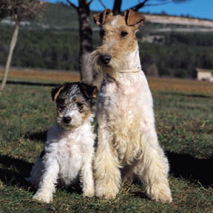
Fox Terrier
May be either smooth or wired, depending on the type of hair coat
http://www.petplanet.co.uk/petplanet/fun/postcards/breedpostcards/Dogs/fox_terrier.jpg

Slide 9
Fox Terrier
One of the best known and most widely distributed purebred dogs noted for their courage in hunting animals that den in the ground
Easy to train, affectionate, and good companion dogs
White should be the dominant color. Brindle, red, or liver are to be avoided

Slide 10
Fox Terrier
http://animal.discovery.com/tv-shows/dogs-101/videos/wire-fox-terrier.htm

Slide 11
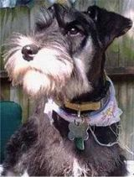
Miniature Schnauzer
German breed developed to hunt badger, fox, weasel, etc.

Slide 12
Miniature Schnauzer
Good apartment dog and pet that is fond of children
Intelligent, hardy and healthy
Less than 20 pounds and only 12-14” in height at the shoulder, stocky and wirehaired

Slide 13
Miniature Schnauzer
http://animal.discovery.com/tv-shows/dogs-101/videos/miniature-schnauzer.htm

Slide 14
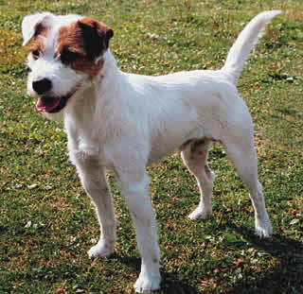
Parson Russell Terrier
Developed around 200 years ago in England by a clergyman, Parson Jack Russell to hunt fox
http://www.lechien.ch/images/races/photos/grandes/parson.jpg

Slide 15
Parson Russell Terrier
Known for its alert, confident, and ready attitude
May have a smooth or wirehaired coat
Color: White with black or tan markings or a combination of three colors
Weight: average 13-17 pounds for males and females
Height at the shoulder: 12-15” for males and females

Slide 16
Parson Russell Terrier
http://animal.discovery.com/tv-shows/dogs-101/videos/jack-russell.htm

Slide 17
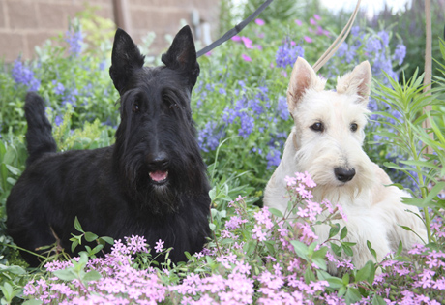
Scottish Terrier
Known as “Scotties”
Originally bred to hunt & kill vermin on the farms
Naturally a digger
Gentle & Loving but spirited which can make training difficult.

Slide 18
Scottish Terrier
http://animal.discovery.com/tv-shows/other/videos/breed-all-about-it-scottish-terrier.htm

Slide 19
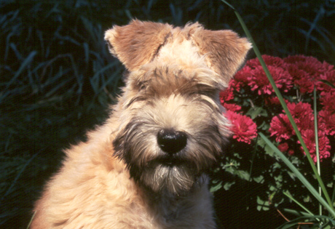
Soft-Coated Wheaten Terrier
Ranging in size from 17 to 19 inches tall at the shoulder and weighing between 30 and 40 pounds.
Small game hunter; farm dog.
Less “scrappy” than other terrier breeds.
Excellent family dog.

Slide 20
Soft Coated Wheaten Terrier
http://animal.discovery.com/tv-shows/dogs-101/videos/soft-coated-wheaten-terrier.htm

Slide 21
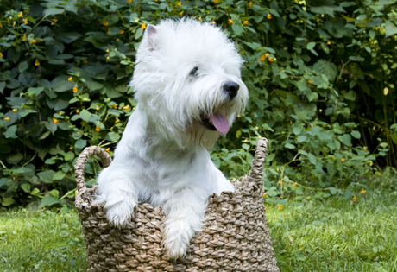
West Highland Terrier
aka The Westie
Loves people
This devoted, happy and faithful dog
Wonderful travel companion due to its small size

Slide 22
West Highland Terrier
http://animal.discovery.com/tv-shows/dogs-101/videos/west-highland-white-terrier.htm

