Slide 1
Toy Group
Animal Science 2- Small Animals

Slide 2
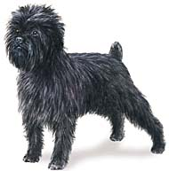
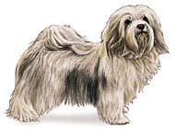
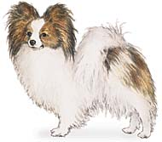
Toy Group
So-named because of their small size, and is most often used as house pets and companions
Havanese
Papillon
Affenpinscher

Slide 3
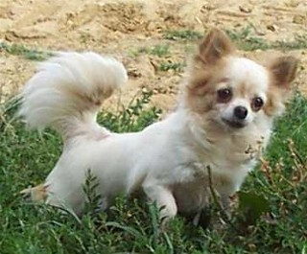
Chihuahua
Named for the state of Chihuahua, Mexico, it is the smallest breed of dog in the world and the oldest breed on the American continent
http://www.chiots-france.com/Trouver-votre-chiot/Des-Animaux-Stars-Chihuahua-1.jpg

Slide 4
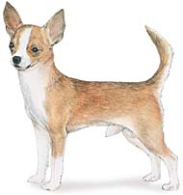
Chihuahua
Noted as a clannish breed that does not like other breeds of dogs
These little dogs are courageous, energetic, lively, alert, and intelligent

Slide 5
Chihuahua
http://animal.discovery.com/tv-shows/dogs-101/videos/chihuahua.htm

Slide 6
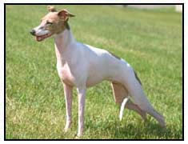
Italian Greyhound
Smallest of dogs that hunt by sight, and is mainly used as a companion or pet
http://www.thepetprofessor.com/breeds/images/Italian-Greyhound-picture.jpg

Slide 7
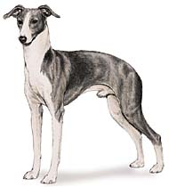
Italian Greyhound
This breed is odorless and has a short, smooth hair coat that sheds little and easy to maintain
Breed is playful and alert around friends, but wary of strangers
Affectionate dog that needs a lot of affection to thrive

Slide 8
Italian Greyhound
http://animal.discovery.com/tv-shows/dogs-101/videos/italian-greyhound.htm

Slide 9
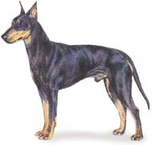
Manchester Terrier
Or Rat Terrier
Originally known for its rat and rodent hunting skills, but is primarily used today as a companion dog
Color: Jet black with rich mahogany tan markings about the face and lower legs

Slide 10
Manchester Terrier
No video at this time.

Slide 11
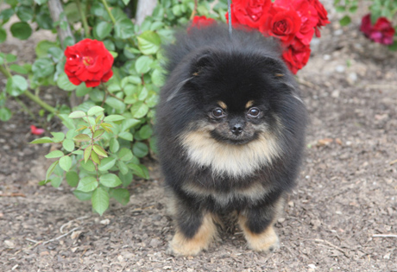
Pomeranian
Very intelligent dogs that love to please.
Because of their outgoing temperaments, they can be very good family dogs with the right training.
Need lots of exercise

Slide 12
Pomeranian
http://animal.discovery.com/tv-shows/dogs-101/videos/pomeranian.htm

Slide 13
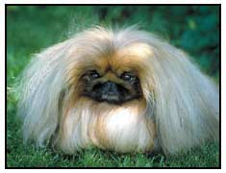
Pekingese
Breed from China that is extremely affectionate with its owner and that make good watchdogs or lapdogs for apartment dwellers
http://www.thepetprofessor.com/breeds/images/Pekingese-picture.jpg

Slide 14
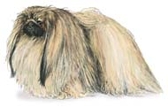
Pekingese
These little dogs are not afraid of larger adversaries and will show great courage
Require teeth care to prevent decay and frequent coat care to keep its long, fine hair well groomed

Slide 15
Pekingese
http://animal.discovery.com/tv-shows/dogs-101/videos/pekingese.htm

Slide 16
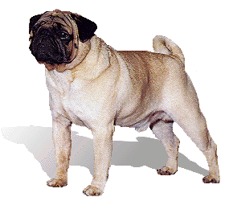
Pug
Very old breed noted for its prominent eyes; short, square muzzle; deep wrinkled forehead; and large massive head
http://www.georgianindex.net/dogs/pug.gif

Slide 17
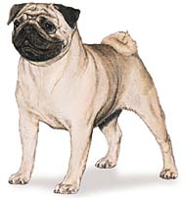
Pug
Intelligent and affectionate dogs that enjoy lots of attention
Easily trained and love children

Slide 18
Pug
http://animal.discovery.com/tv-shows/dogs-101/videos/pug.htm

Slide 19
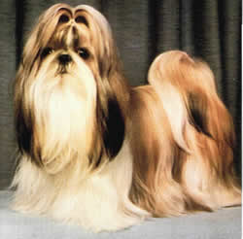
Shih Tzu
Chinese breed with a long, flowing hair coat that requires constant care to prevent matting and knotting
http://www.thebreedsofdogs.com/images/SHIH_TZU.jpg

Slide 20
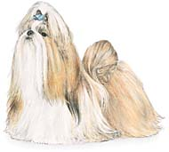
Shih Tzu
Color: Eyes and nose are rim black with any coat color
Looks like a miniature lion and has an aristocratic, arrogant carriage

Slide 21
Shih Tzu
http://animal.discovery.com/tv-shows/dogs-101/videos/shih-tzu.htm

Slide 22
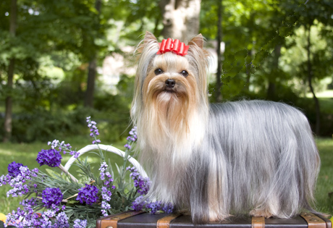
Yorkshire Terrier
Originally owned by the working class and used to hunt out vermin in mills
Now owned by high society
Great family pet
Very adaptable and trainable

Slide 23
Yorkshire Terrier
http://animal.discovery.com/tv-shows/dogs-101/videos/yorkshire-terrier.htm

