Slide 1
Working Group
Animal Science 2- Small Animals

Slide 2
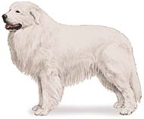
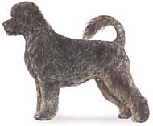
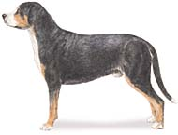
Working Group
Perform a service to humans such as pulling sleds, protecting property, doing rescue work, and carrying messages
Great Pyrenees
Greater Swiss Mountain Dog
Portuguese Water Dog

Slide 3
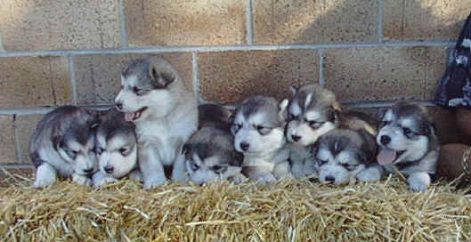
Alaskan Malamute
An Artic sled dog noted for their cleanliness, being odorless.
http://www.pgaa.com/canine/general/images/MALAMUTE8puppiesbest2.jpg

Slide 4
Alaskan Malamute
They do not bark
Always has a white underbody and white on parts of the legs, feet, and part of the mask markings

Slide 5
Alaskan Malamute
http://animal.discovery.com/tv-shows/dogs-101/videos/alaskan-malamute.htm

Slide 6
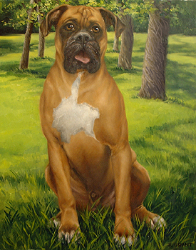
Boxers
Descended from fighting dogs of Tibet
http://www.ergstudios.com/Boxer%201.jpg

Slide 7
Boxers
Somewhat suspicious of strangers, but good natured dog
Requires regular exercise to help prevent rheumatism and has a short life span of usually less than 10 years
Colors are fawn and brindle with white markings possible on the chest and face

Slide 8
Boxers
http://animal.discovery.com/tv-shows/dogs-101/videos/boxer.htm

Slide 9
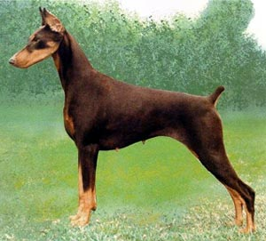
Doberman Pinscher
A German breed that is a result of crossing Great Danes, German Shepherds, Rottweilers, and Pinschers
http://www.westminsterkennelclub.org/breedinformation/working/images/dobpinr.jpg

Slide 10
Doberman Pinscher
Female Dobermans are cautious around strangers, but are affectionate and calm with family
Male Dobermans are extremely intelligent but are often very aggressive and need a strong owner who is good at managing the dog
Often live as long as 20 years of age (long time for dogs)

Slide 11
Doberman Pinscher
http://animal.discovery.com/tv-shows/dogs-101/videos/doberman.htm

Slide 12
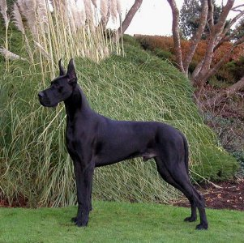
Great Dane
One of the two largest breeds of dos and is friendly companion or watchdog
http://www.takingthelead.co.uk/images/Dog%20breeds/Great%20Dane/great-dane-pictures-1a%5B1%5D.jpg

Slide 13
Great Dane
Weight: average 110-115 pounds for females, 120-150 pounds for males
Height at the shoulder: more than 28” for females, more than 30” for males

Slide 14
Great Dane
http://animal.discovery.com/tv-shows/dogs-101/videos/great-dane.htm

Slide 15
Standard Schnauzer
Uses include family pet, watchdog, and bodyguard
Very clean and almost odor free, the breed is noted for a long life span
Color: Salt and pepper, or pure black

Slide 16
Standard Schnauzer
http://animal.discovery.com/tv-shows/other/videos/breed-all-about-it-schnauzer.htm

Slide 17
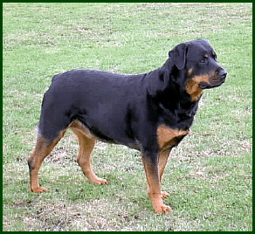
Rottweiler
Came from the Mastiff type dogs of Rome and was used to drive cattle to market
http://www.rottweiler.on.ca/treu1.gif

Slide 18
Rottweiler
Massive and powerful, but peaceful, obedient, and extremely intelligent dogs that are very protective of their owners
Very good companion dogs, but are also used as bodyguards, watchdogs, police dogs, and herd dogs
Color: Always black with rust to mahogany markings about the face and feet

Slide 19
Rottweiler
http://animal.discovery.com/tv-shows/dogs-101/videos/rottweiler.htm

Slide 20
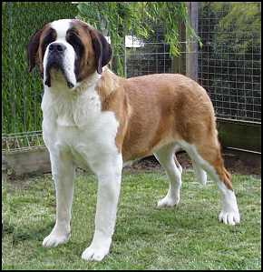
Saint Bernards
One of the two largest breeds
http://www.webpage-world.com/vicjudges/images/saintS2.jpg

Slide 21
Saint Bernards
Excellent sense of smell and coat made it suitable to perform rescue in extreme mountain climate conditions
Peaceful, quiet, and gentle dog that loves the company of humans and makes a good companion dog
Color: Red with white markings or white with red markings

Slide 22
Saint Bernards
http://animal.discovery.com/tv-shows/dogs-101/videos/saint-bernard.htm

Slide 23
Samoyed
Breed from Siberia
Excellent companion and watchdog that likes to bark, but is very gentle, kind, and especially loving of children
Many believe it is the most beautiful breed in existence
Color: pure white

Slide 24
Samoyed
http://animal.discovery.com/tv-shows/dogs-101/videos/samoyed.htm

Slide 25
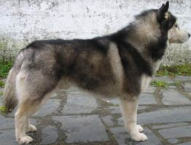
Siberian Husky
Originated in Asia as an endurance sled dog, but found its home in Alaska when it began to win the All Alaska Sweepstakes Race in the early 1900’s
http://www.glacierwind.net/husky-siberiano/black/siberian-husky-1-262x200.jpg

Slide 26
Siberian Husky
Friendly, gentle dog, but may be stubborn and ill around children
Does not have the aggressiveness or protective qualities to be a watchdog
Color: Pure white to all other colors including black

Slide 27
Siberian Husky
http://animal.discovery.com/tv-shows/dogs-101/videos/siberian-husky.htm

